Slide 1
Noise
Richard Stump

Slide 2
1) Problem

Slide 3
1) Problem:
Implement Noise Functions
Visualize them in a cool way
Make it run in real time

Slide 4
2) Solutions

Slide 5
Generating
Pre-calculate lookup tables
For each sample, calculate its integer coordinates and use the lookup table
Transform coordinates by octaves and scale
Take weighted sum of octaves

Slide 6


Slide 7
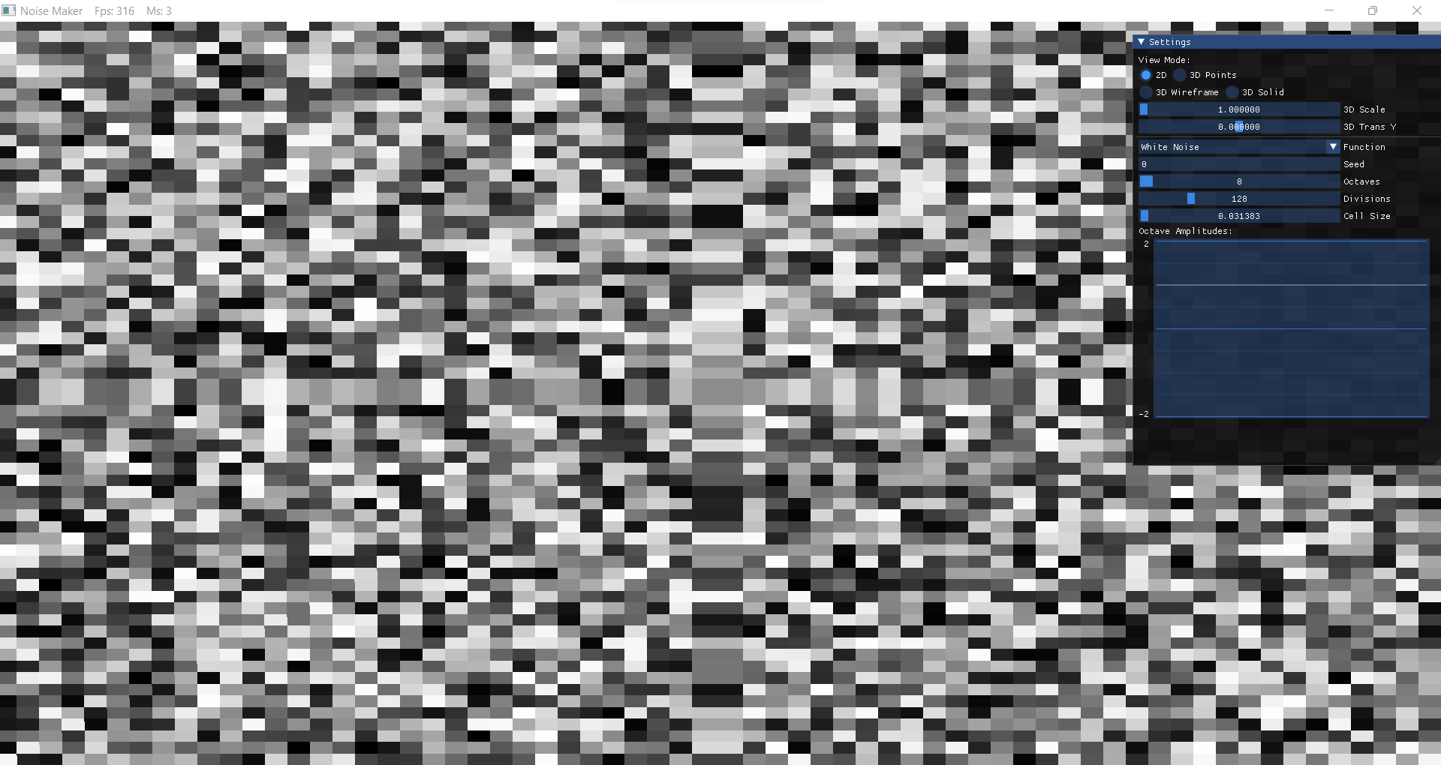
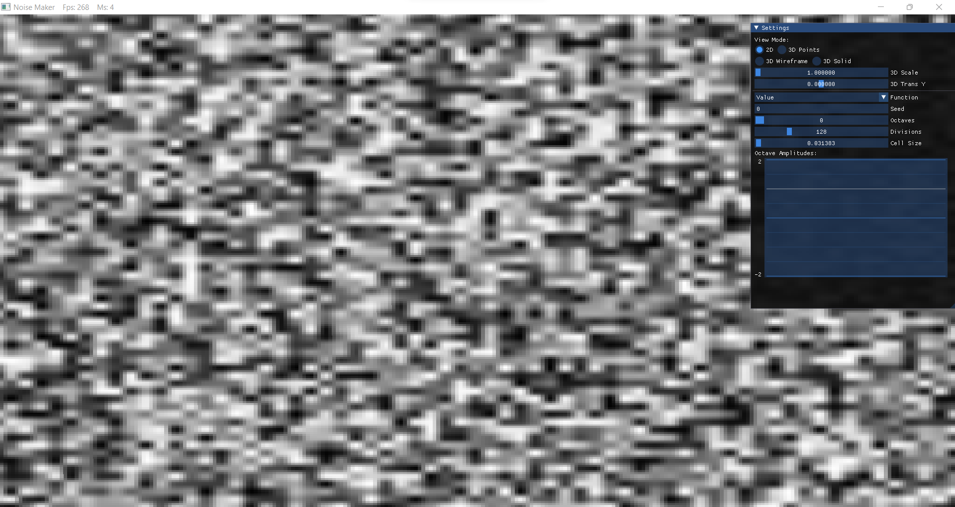
Functions
White Noise:
Give each integer coordinate a random value
Use value of nearest integer coordinate
Value Noise:
Same as white noise, except values are interpolated between nearest grid points

Slide 8
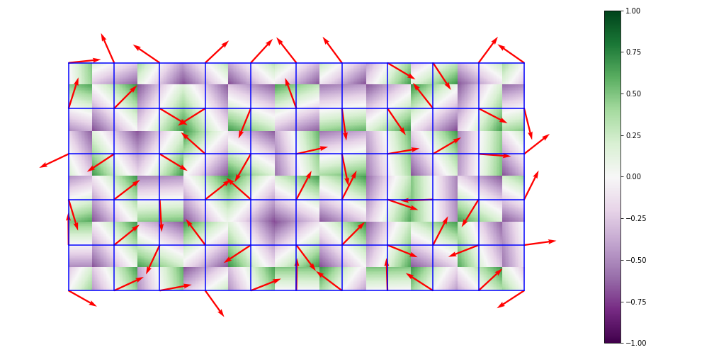
Functions
Perlin Noise:
Give each grid point a random direction (gradient)
Take dot product
Interpolate between dot products
https://en.wikipedia.org/wiki/Perlin_noise

Slide 9
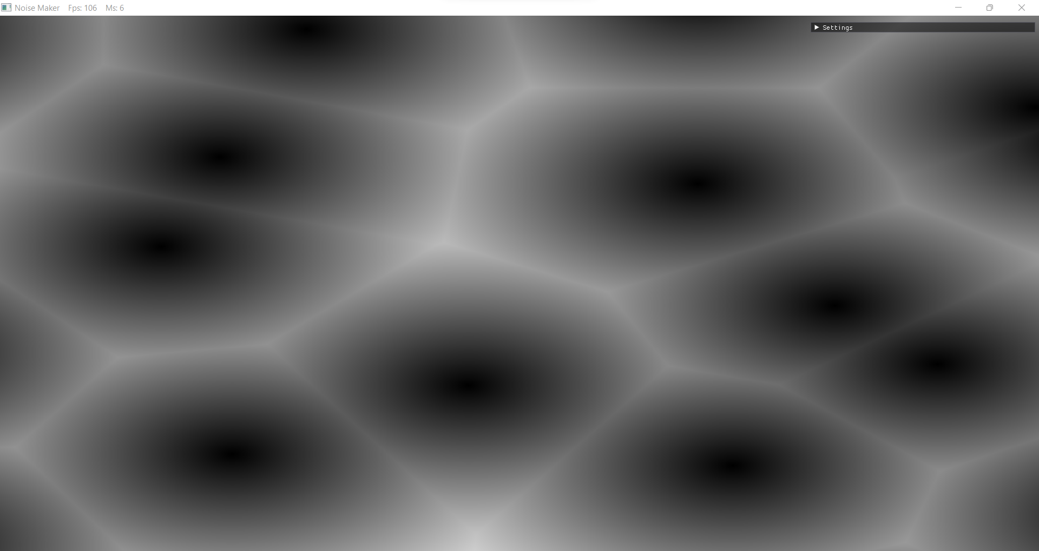
FUNCTIONS
Worley
Give each cell a random point
For a sample point, result is the distance to the closes point
Worley F2
Same as Worley, but using 2nd closest point

Slide 10
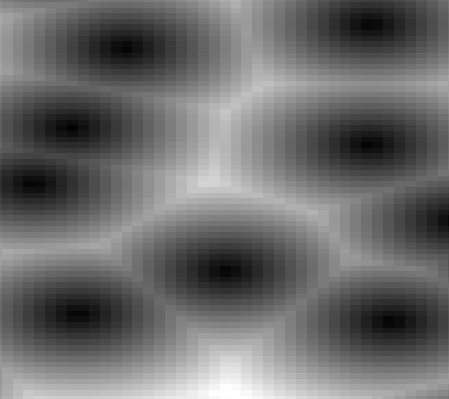
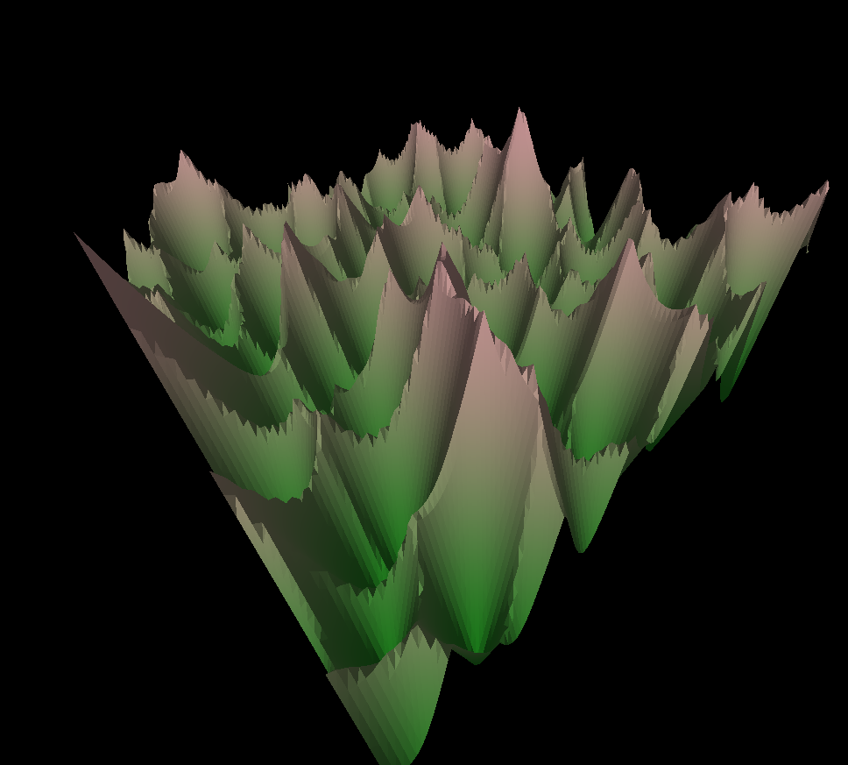
Visualizing
Sample noise to a buffer
Use single buffer to visualize it different ways
Grayscale texture
Sample points
Wireframe
Filled Triangles

Slide 11
3) Code description

Slide 12
For each Noise Function:
Inherit from a common base class:
float sample(float x, float y)
void reseed(int seed)
Pre-calculate 256x256 table of random values in constructor
Use coordinates of samples
Use closes integer coordinates to index table
Combine results

Slide 13
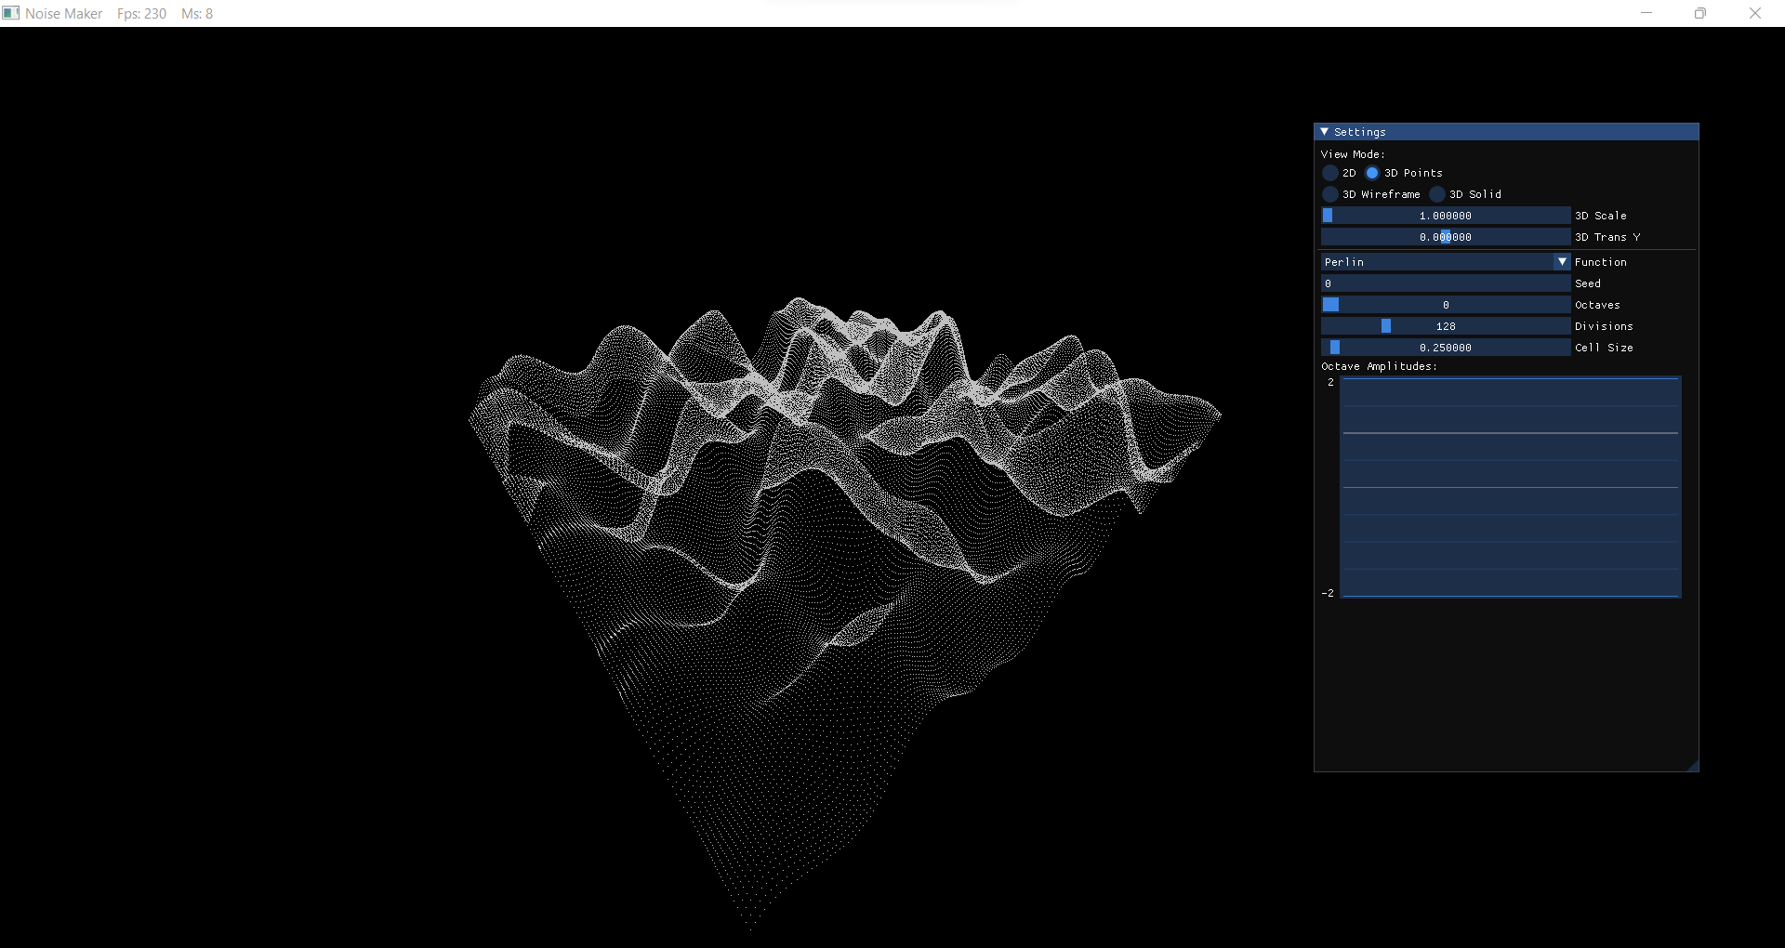
Main Loop:
Handle UI
If the seed changes, regenerate the lookup table
If any other parameter changes, resample
Render according to the selected method
2D – The buffer is a texture
3D – Generate points on the fly

Slide 14
4) Live demo

Slide 15
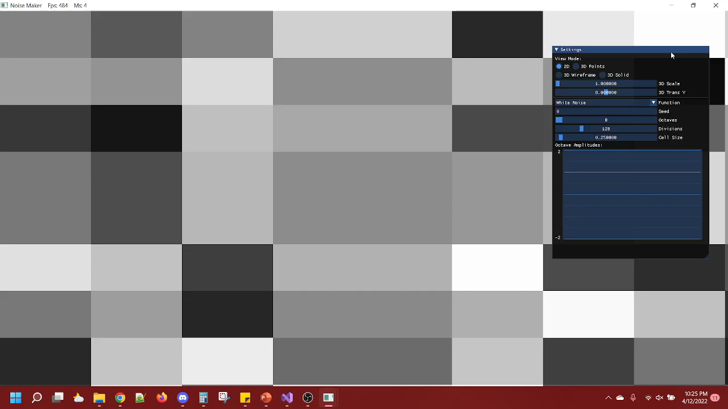
Backup video
https://youtu.be/c2gzPOT0tbk

Slide 16
5) Limitations and Problems

Slide 17
Limitations:
Problems:
One function at a time
Octaves have set frequency
No turbulence
Texture output is grayscale
Memory efficiency could be improved
3D Views are very GPU intensive at higher detail levels

Slide 18
6) Future Work

Slide 19
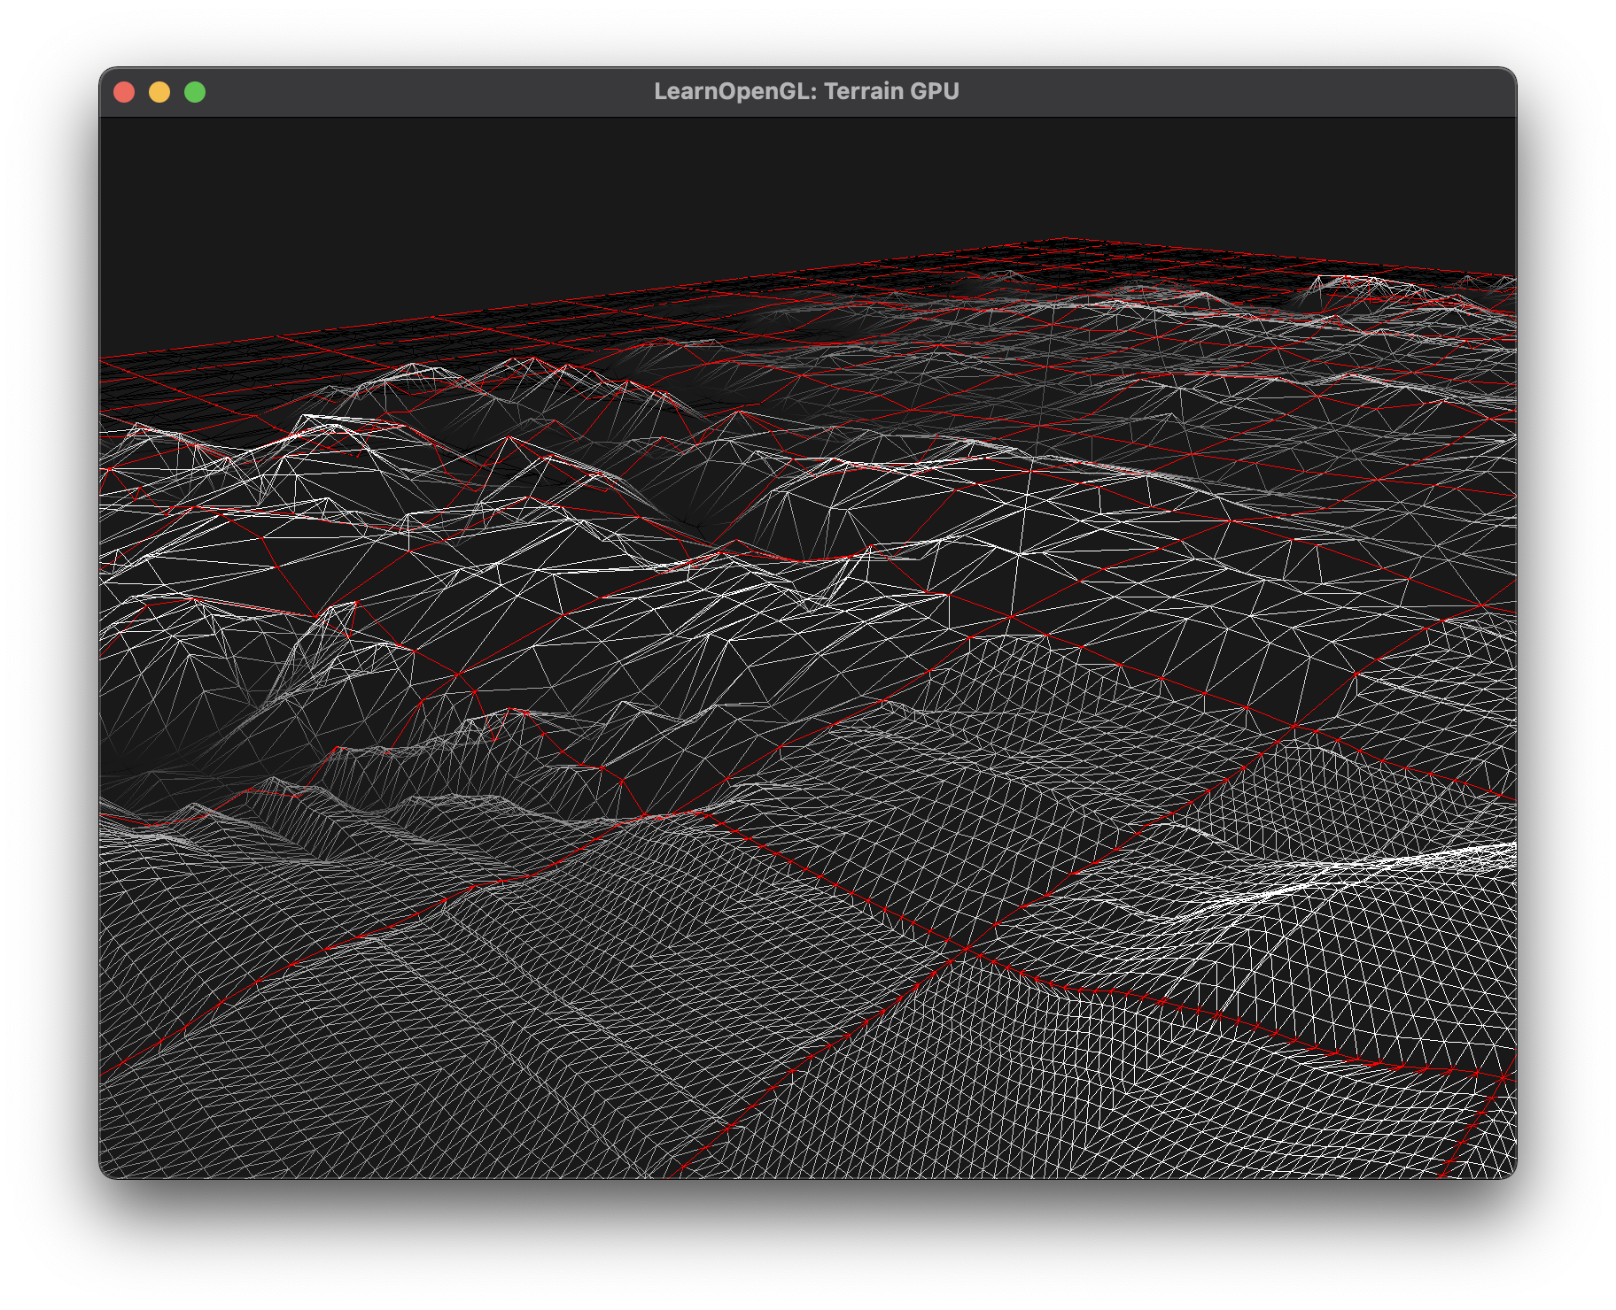
Tessellation Shaders
Level of detail changes with distance
Reduces GPU workload
https://learnopengl.com/Guest-Articles/2021/Tessellation/Tessellation

Slide 20
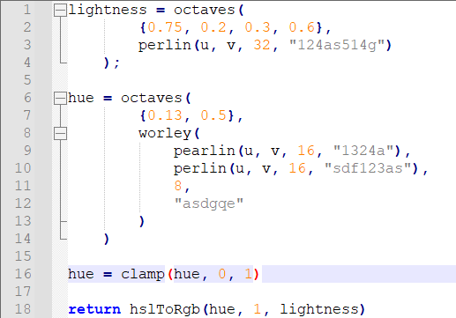
Add a Scripting system
Possibly Lua
Compose and combine in weird ways
Akin to Ken Perlin’s image synthesizer

Slide 21
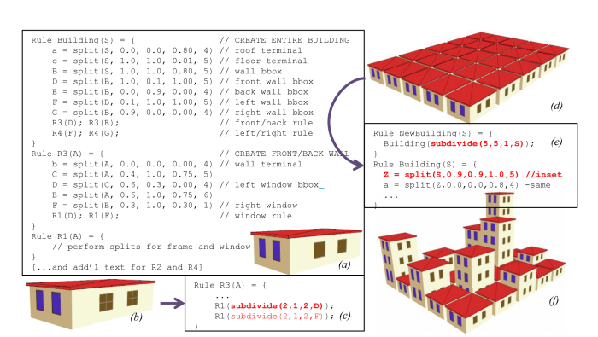
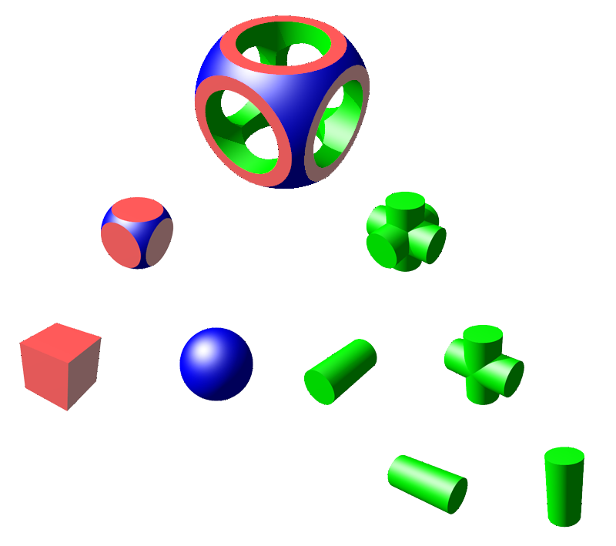
Procedural modeling
Split Grammars?
Guided Procedural Modeling?
Constructive Solid Geometry?
İ. Demir, D. G. Aliaga and B. Benes, "Proceduralization for Editing 3D Architectural Models," 2016 Fourth International Conference on 3D Vision (3DV), 2016, pp. 194-202, doi: 10.1109/3DV.2016.28.
https://en.wikipedia.org/wiki/Constructive_solid_geometry

Slide 22
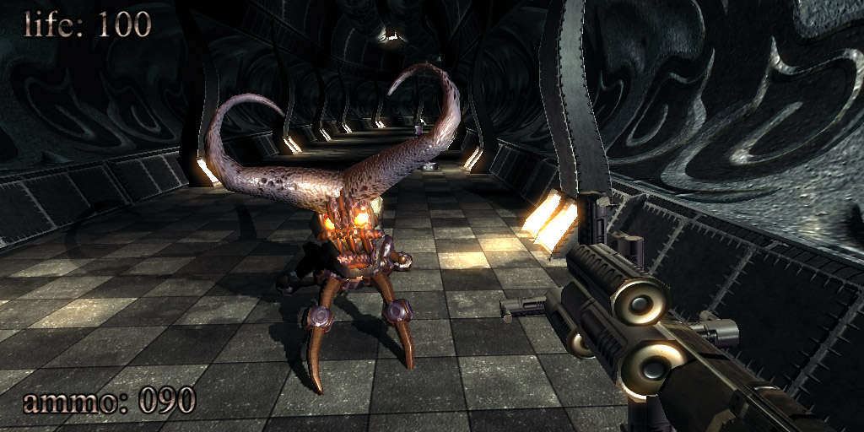
Procedural world/game
Super small disk footprint
Reminiscent of the demo scene
.kkrieger – a 96kb FPS made in 2004
https://commons.wikimedia.org/wiki/File:.kkrieger_1.jpg

